Slide 1

SAP Analytics cloud training
Anubhav Oberoy
Day 13

Slide 2
Agenda – Day 13
Regression Scenario
Single v/s Multi Regression
Accuracy Calculation
MAPE
Notes:
Data Actions & Connections Basics
Data Actions in SAC
Introduction to Connections
Cloud Connector
Connecting to Import data with BW
Connecting to S/4HANA System
---Break---
Build CDS Views
Introduction to CDS View
Consume S/4HANA CDS views
Import data connection
Live Data connection with analytic Query

Slide 3

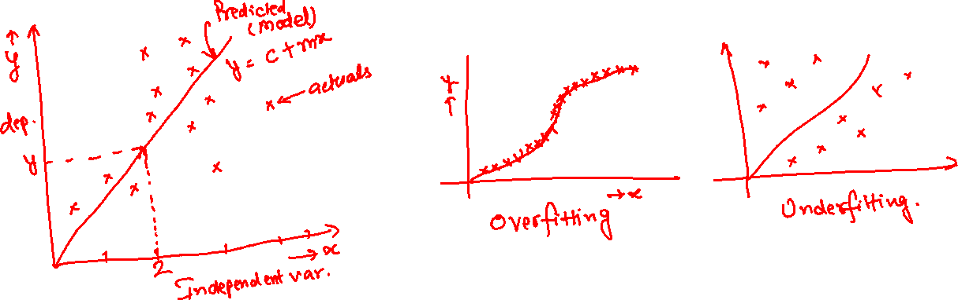
Regression
Is a scenario which is used to predict a single value (target variable) which of type continuous nature. When your dependent variable is numberic.
Find if a patient is suffering from corona or not – No (classification)
Predict the price of my house – Yes (price of a house is a number)
If the dependent variable depends exactly on one independent variable, its called linear regression. If the dependent variable depends on multiple independent variables, its called multi-regression. Y = c + mx.
www.anubhavtrainings.com

Slide 4
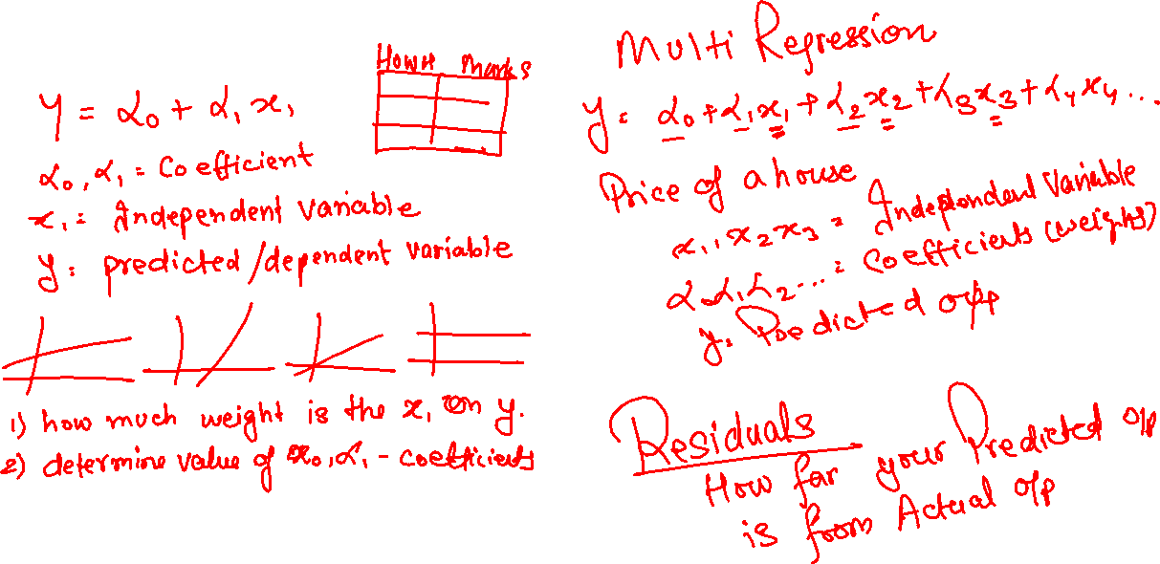
Single v/s Multi Regression
Single Regression
www.anubhavtrainings.com

Slide 5
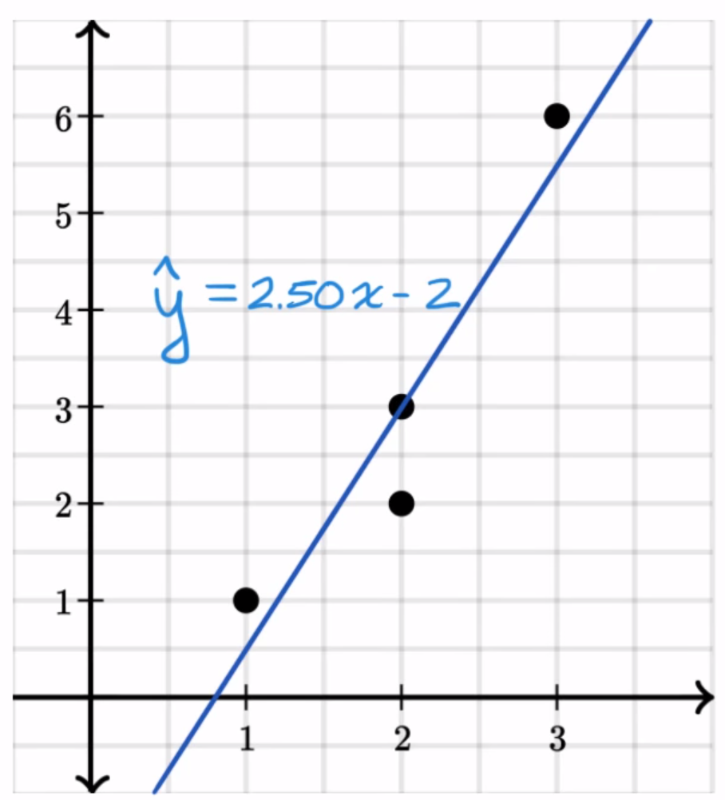
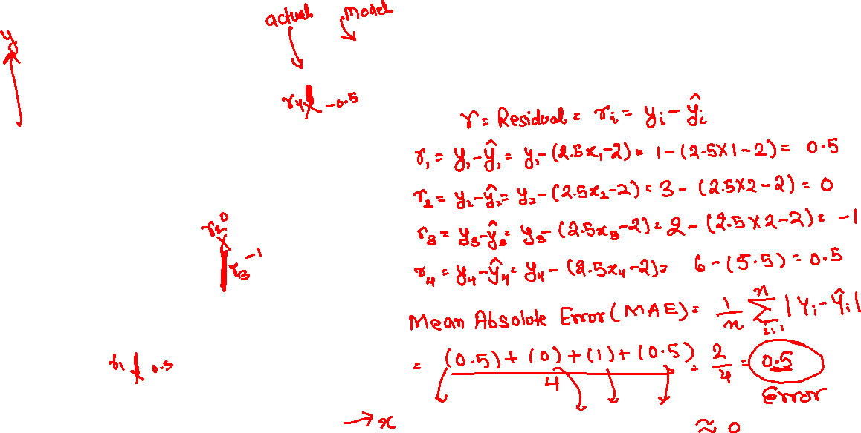
Accuracy of the Regression
<>
We always compare the predicted output with actual output during the validation process. With the help of that we get to know how far my predicted result of ML model is from the reality so that next time when we apply Ml, we can be confident to get similar result. In case of regression we use residual.
www.anubhavtrainings.com

Slide 6
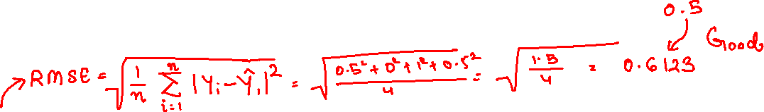
Different formulas
MAE – Mean Absolute Error, its just an average error of our data.
RMSE – Root mean square Residual – if we double the error, will it deviate too much. It is a way to check the robustness of the model.
www.anubhavtrainings.com

Slide 7
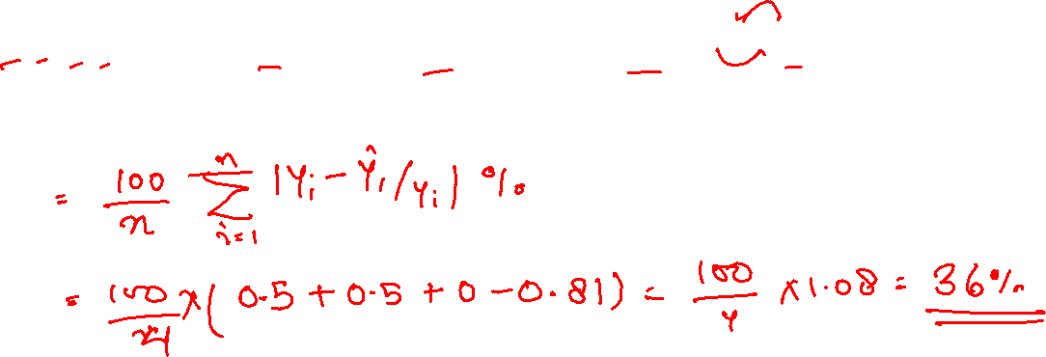
MAPE – Mean Absolute Error Percentage
Sometimes the value of RMSE might float between 0 to infinity which will be difficult to interpret by the consultant. In order to make business understand how robust and dependable our ML model is, we use a another marker called MAEP
www.anubhavtrainings.com

Slide 8
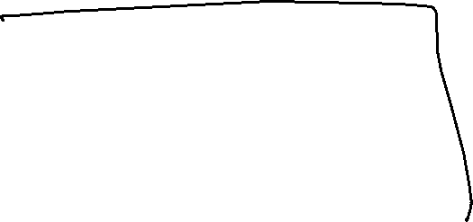





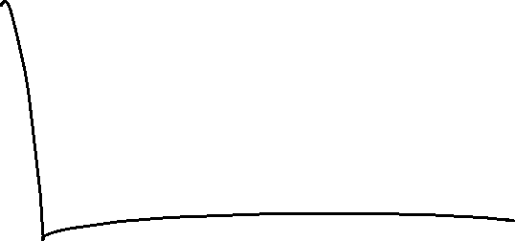
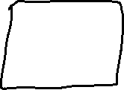


Time Series
If you want to predict values which are of nature continuous (number). Unlike regression, in the time series our goal is to predict the trend also. Which means multiple values which are function of time.
Time series will help
Multiple values which are factor of time
Output predicted based on a segment
One axis is always time
www.anubhavtrainings.com

Slide 9


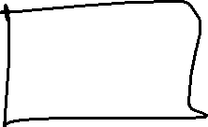
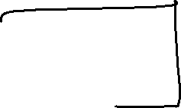

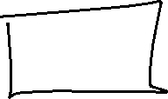

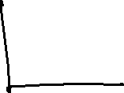

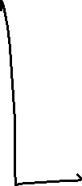

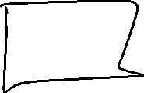





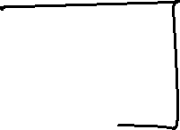


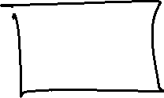

Expenditure and Revenue
www.anubhavtrainings.com

Slide 10
End of Day 13

Slide 11

Questions

Slide 12

Anubhav Oberoy
anubhav.abap@gmail.com

